Slide 1
NYC Taxi Fare Prediction
Group 1
Guilherme, Alex, Rakshit, Seonhye, Michael
Notes:
We are group 1 and our project is NYC taxi fare prediction.

Slide 2
Agenda
Problem Background
Preprocessing
EDA
Models
GPU Acceleration
Results
Conclusion
Future Work
Utilized Class Topics
Notes:
We will discuss the background of the problem and why it’s important
We will also discuss EDA and the models/methods used.
Lastly we will discuss the results and conclusion. And also discuss future work.

Slide 3
Problem Background
Target:
Predict fare of a taxi ride
Features:
Pickup time and coordinates
Drop Off coordinates
Passenger count
Historical Results:
$3-5 MAE using just ride distance
Notes:
We decided to work on this problem because taxis are still the most popular use of transportation in new york city.
Prices are affected by tolls, distance, flat rates and so on.
However, users want to know the price of the taxi fare before using the service.
In order to give users this sort of information, we worked on a taxi price prediction problem.

Slide 4
Preprocessing
Drop rides that seem faulty/fake
0 or more than 6 passengers
Below $3 and above $150
Low distance (< 1 km) with excessively high fares (>$40)
Compute geographical distances
Label pick-up and drop-off areas
Then one-hot encoded
Dropped unused columns

Slide 5
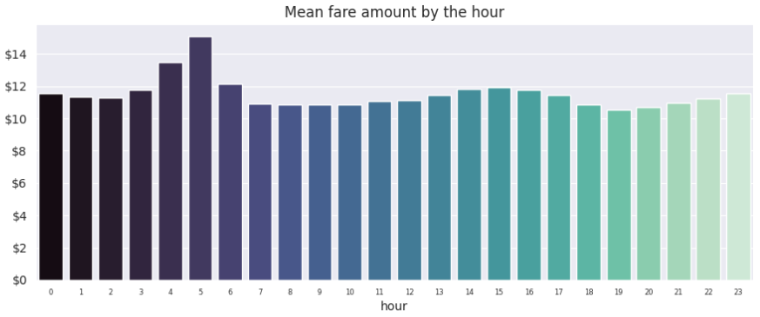
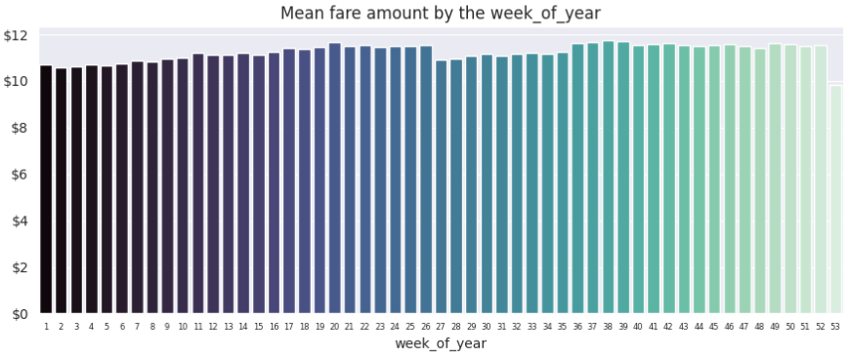
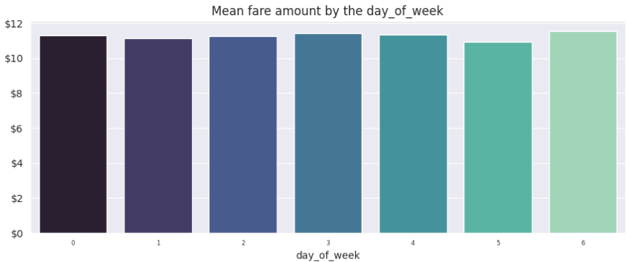
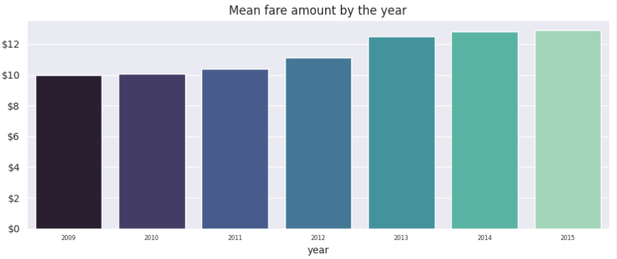
EDA - Features
Notes:
Some interesting facts:
Average fare is most expensive in the early mornings such as 5am when there is least demand
Average fare by the week is pretty consistent
Average fare by the day of the week is also pretty consistent as well
Average fare per year seems to be growing every year which is good

Slide 6
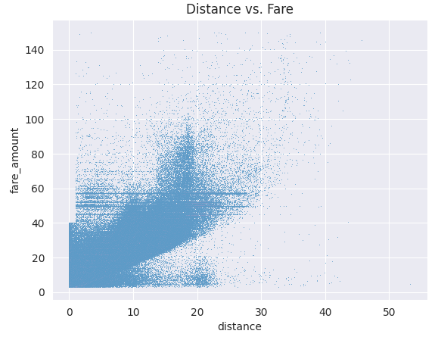
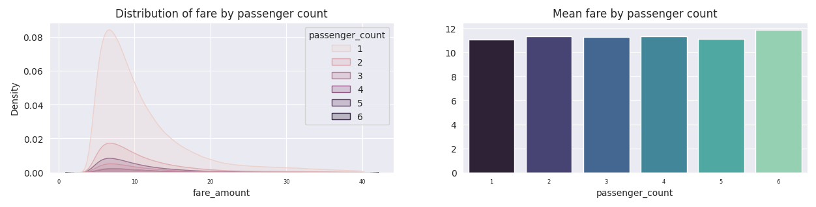
EDA - Features
Notes:
Looking at the EDA, we can see some interesting information.
Majority of taxi users are single users.
The price seems to be low during the early morning hours and price surges during the late nights.
When looking at the days of the week, we can see the prices are pretty steady.
Another interesting feature is that the first half of the week is also when prices are highest and the second half is lower.

Slide 7
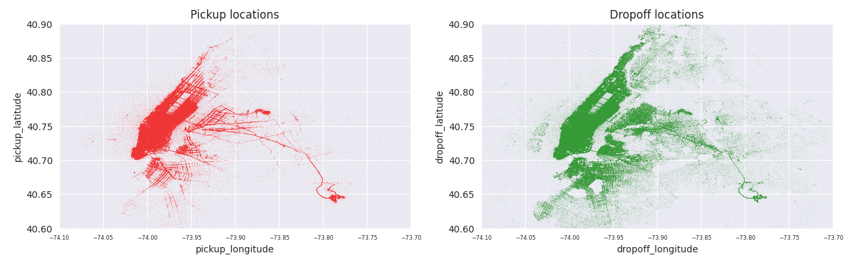
EDA - Features

Slide 8
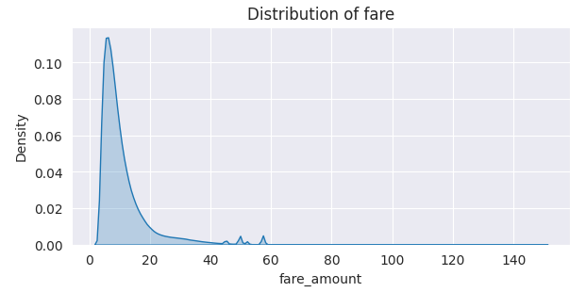
EDA - Features

Slide 9
Models
Linear Regression
Scikit-Learn and CuML versions
Random Forest
Scikit-Learn and CuML versions
XGBoost
Model Objective: Minimize RMSE of Taxi Fare prediction
RMSE penalizes larger errors
We report Mean Absolute Error (MAE) for human understanding

Slide 10
GPU Acceleration
We used CuDF and CuML libraries, developed by NVIDIA for work on NVIDIA GPUs.
CuDF is a GPU-accelerated dataframe library that is API-compatible with Pandas
Utilizes similar Pandas syntax with GPU acceleration
CuML is a machine learning library of machine learning algorithms optimized for GPU acceleration
Designed to work seamlessly with CuDF
File size and device memory constrained how much data we could utilize
Required to use only 10% of given data to utilize CuML
Attempted PyTorch implementations failed entirely

Slide 11
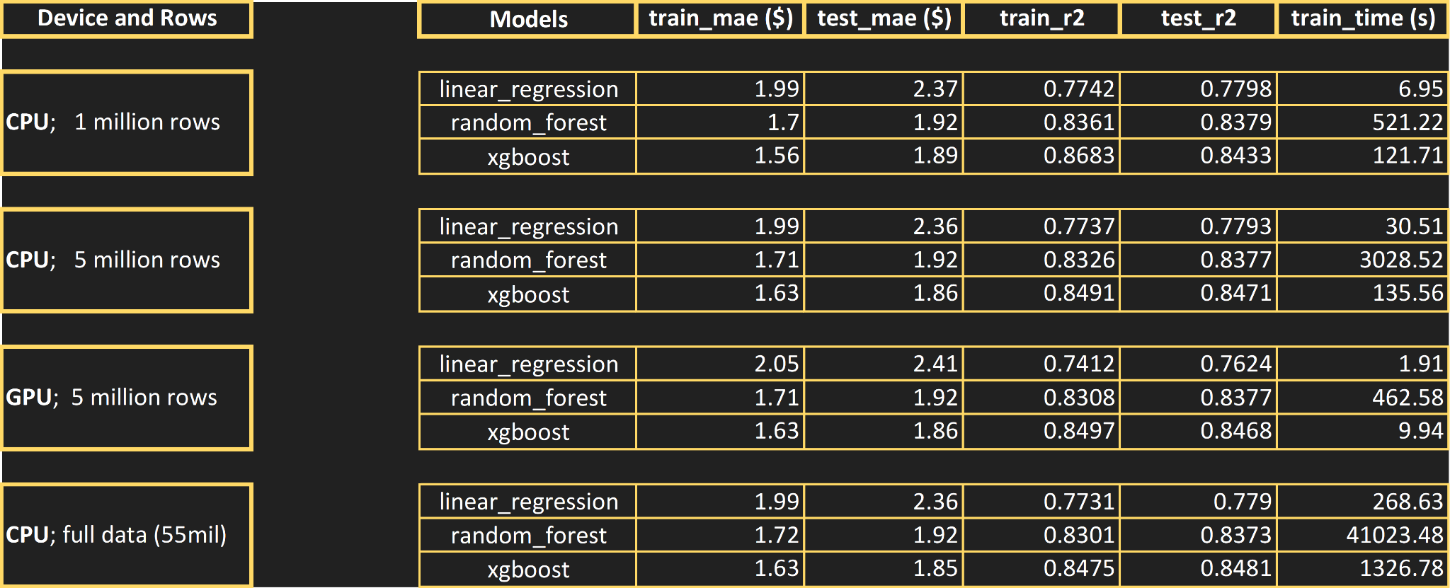
Results
Notes:
Different machines have similar results; XGBoost performed the same nearly for CPUs due to auto-parallelization

Slide 12
Conclusions
Best Model: XGBoost
Best MAEs and R^2 scores
Ran very efficiently compared to Random Forest
Linear Model close performance, but faster
More suitable for tasks demanding speed
GPU fastest training speed
Suitable for tensor-like data
Harder to get devices with required memory
Best Test MAE: $1.85
Still large error for fair prediction, needs improvement
Insignificant MAE difference between 5mil and full, significant speed difference

Slide 13
Future Work
Utilize machines with more memory to use the full dataset
Properly tune model with such hardware
Parallelize the computation more with more apt machines
Utilize Google Maps API to try GPS distances and traffic levels as features
Required funding for practical use
More precise EDA and cleaning
Finely remove outliers that cannot exist
Like being below base-rate
Breakdown pick-up and drop-off locations more finely
Like how going to an airport entails additional fees beyond regular rates

Slide 14
Utilized Class Topics
Shell
Python Performance
Optimization
Parallel Programming
Python for GPUs

Slide 15

ANY QUESTIONS?

